Slide 1
Branching Strategies
- Nagaraju Brahmanapaly

Slide 2
WHAT is Branching?
WHY do we need Branching?
Low cost Operations
Isolate your work
Organize your workflow more efficiently
Safely experiment with new ideas

Slide 3
Types of Branches
Main (Master)
Develop (Integration)
Feature
Release
Hotfix
Notes:
Feature branches – Feature/Topic branches are often a branch of the origin/develop branch and used to work on features for the next or future releases. They only exist when the feature is under development and will be merged back into the origin/develop branch.
Release branches – are usually a branch from a point-in-time of the origin/develop where it’s deemed ready for a release. It exists to facilitate a production release. Additional minor work(adding version.txt files) may happen on a release branch before it’s merged into the origin/master and origin/develop
Hotfix branches – are generally indicate fixes for issues in production that are discovered post-release. These are created from the origin/master and the changes merged into both origin/develop and origin/master branches.

Slide 4
Types of Branching Strategies
Git Flow
GitHub Flow
Tofu Scale
Release Flow

Slide 5
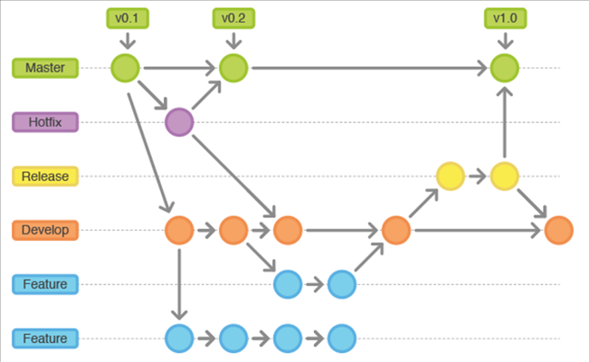
Git Flow

Slide 6
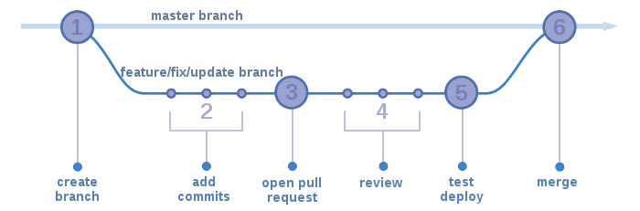
GitHub Flow
https://guides.github.com/introduction/flow/

Slide 7
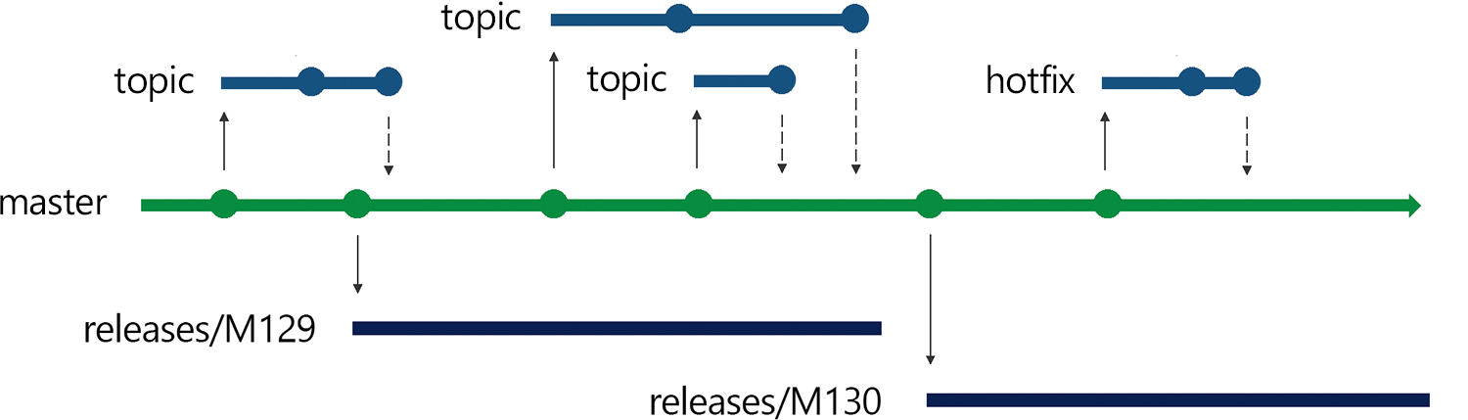
Release Flow

Slide 8
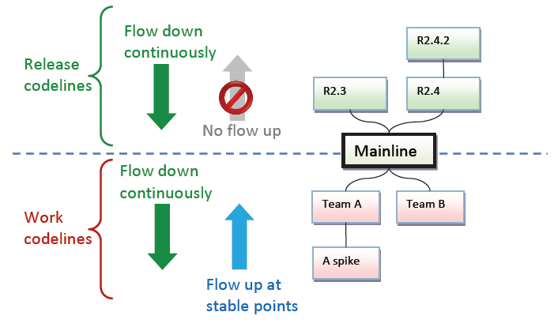
Tofu Scale
More
stable
Less
stable

Slide 9
So Which One Should I use ?
What type of product are we releasing?
Will we be required to maintain multiple releases of this product in production ?
Do we need continuous deployment ?
Is our team better suited and experienced at using Release branches ?

Slide 10


